Slide 1

FAST AND SLOW LLMS
A Solution to the Email-to-API Mapping Problem
Daniel Clas, Aida Rostami

Slide 2
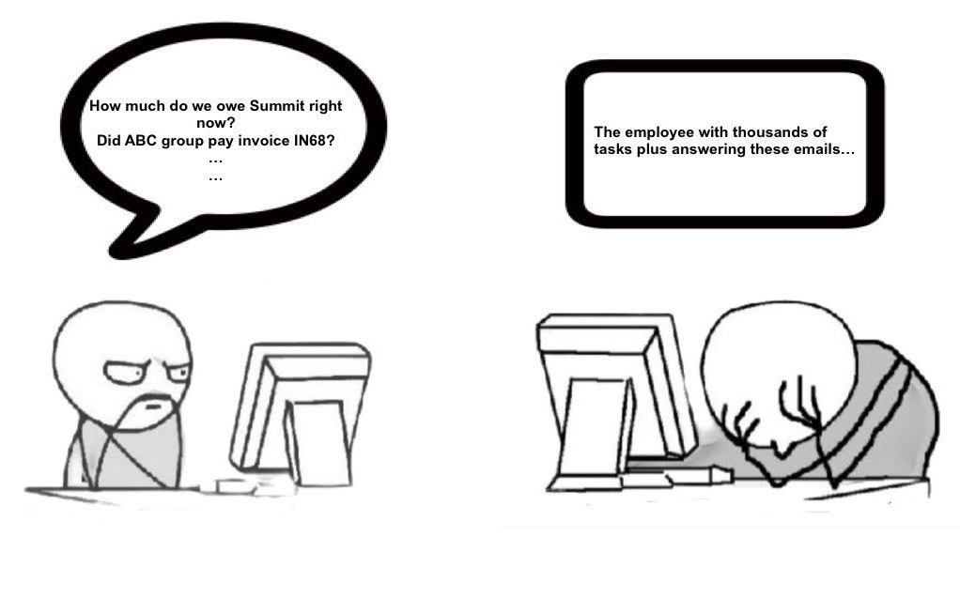
The Email Answering Problem
The company’s human resources team is already burdened with a high volume of daily tasks, yet they are still required to handle and respond to such emails regularly.
01
02

Slide 3

What if email handling could be automated?
We designed an intelligent system that uses large language models to read incoming emails, understand their intent, and decide on the right action, all while mimicking human-like fast and slow thinking.

